Slide 1

Cryptography by using qr code encryption method
Information Systems And Audit Project work

Slide 2
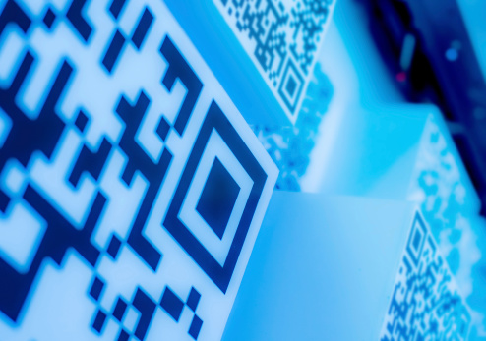
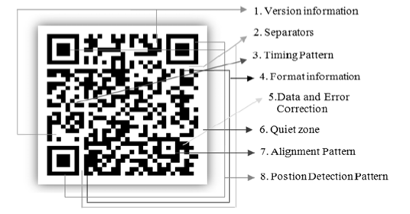
Introduction
What Is QR Code?
Quick Response (QR) code as shown in Figure 2.1 is a barcode standard developed by Japanese company Denso Wave in the 1990s. Compared to traditional 1D (1-dimensional) barcodes, QR codes are 2D (2-dimensional), allowing for a greater amount of information storage. QR code consists of a black square pattern on white background and it contains information in the vertical direction as well as the horizontal direction. QR codes have a wide variety of uses.

Slide 3

Why is QR Code important?
Nowadays, it is almost impossible to secure and hide personal confidential information like system credentials. These info can be easily hacked and used for unauthorized purposes. Such hacked information can cause huge loss to a person.
Quick Response (QR) codes are being used increasingly to share data for different purposes such as authentication, verification, etc.
The popularity of QR code is because of its high data capacity, error correction capability using Reed-Solomon error correction algorithm, fast decoding, etc.
However, most existing QR code systems use insecure data format and encryption is rarely used.
It is possible to use secure QR code technology to keep his important sensitive information perfectly secured at all times, without the information gets leaked to outside world.

Slide 4

Problem Statement
Hacking personal confidential information has become a significant problem these days. Persons are facing privacy threat and financial losses as a result of unauthenticated and unauthorized information. So, hiding and securing personal confidential information has become a serious need; so, an effective and uniform process need to be designed and implemented for verifying the authenticity of personal confidential information as well as for authorizing the personal confidential information.

Slide 5

Project Plan
Problem Statement Analysis
Application Design Analysis
Prototype Making
Review of the prototype
Implementation of the Same
Testing of the product
Documentation
Submission

Slide 6

The Domain that we have chosen to implement our project is:
FINANCE

Slide 7

Role Of QR Code:
Enable QR code-enabled secure transactions
Provide a top-notch mobile banking experience
Marketing and advertising
Seamless asset tracking
QR codes for KYC and other compliance regulations
ATM transactions with QR codes

Slide 8

Benefits Of QR in Finance:
Improved consumer experience
Streamlined operations
Higher accessibility of services
More impactful marketing
Higher security

Slide 9

Prototype Making
- Introduction:
- Generate a QR code with an encrypted message.
- Scanning the QR code redirects to a website for decryption.
• Encryption: - Use Fernet encryption algorithm for message security.
• QR Code Generation:
Utilize qr-code library to generate QR codes.
Parameters for version, box size, and border.
• Message Encryption:
Encrypt message using Fernet cipher.
Convert encrypted message to URL-safe format.
•-Website Redirection:
QR code redirects to "https://retail.onlinesbi.sbi/retail/login.htm".
Decrypt encrypted message on the website.
• Conclusion:
- Securely transmit encrypted data via QR codes.
- Enhance communication and data privacy.

Slide 10

Review Of the Prototype
Algorithm:
1.Generate a new encryption key using the Fernet algorithm.
2. Create a Fernet cipher instance using the generated key.
3. Encrypt the desired message using the Fernet cipher.
4. Convert the encrypted message to URL-safe format.
5. Generate a QR code using the QR-code library with the URL-safe encrypted message.
6. Save the QR code image.
7. Display or distribute the QR code for scanning.
8. When the QR code is scanned:
Redirect to the specified website, e.g., "https://retail.onlinesbi.sbi/retail/login.htm".
Retrieve the encrypted message from the URL parameter.
Use the Fernet cipher with the encryption key to decrypt the message.
9. Perform any necessary actions with the decrypted message.

Slide 11

Implementation of the prototype
import os import qrcode from cryptography.fernet import Fernet # Generate a random encryption key key = Fernet.generate_key() cipher_suite = Fernet(key) # Message to be encrypted and encoded in the QR code message = "This is a secret message." # Encrypt the message encrypted_message = cipher_suite.encrypt(message.encode()) # Generate the QR code qr = qrcode.QRCode(version=1, box_size=10, border=4) qr.add_data(encrypted_message) qr.make(fit=True) # Specify the path to the desktop folder desktop_path = os.path.join(os.path.expanduser("~"), "Desktop") # Save the QR code as an image file on the desktop image_path = os.path.join(desktop_path, "encrypted_qrcode_downloads.png") image = qr.make_image(fill_color="black", back_color="white") image.save(image_path)

Slide 12

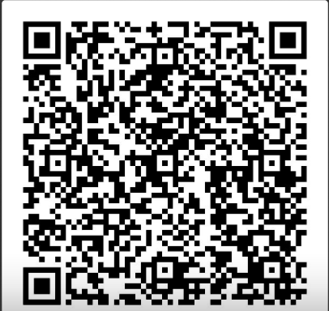
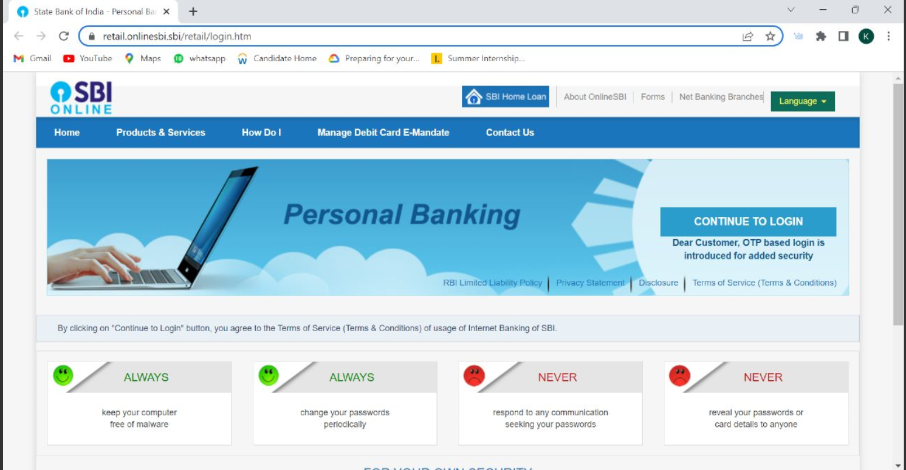
Outcome of the prototype
QR code Encrypting SBI Web Page For easy access and net-banking.
The web Page that opens when you scan the QR on the left Side.
Go give it a try!!!

Slide 13

Rishima Chowdhury – 21BCE1097
Likhita Kolli – 21BCE5664
Kanishka Verma – 21BCE1412

